Slide 1


Lesson 1 History
UNIT 2

Slide 2
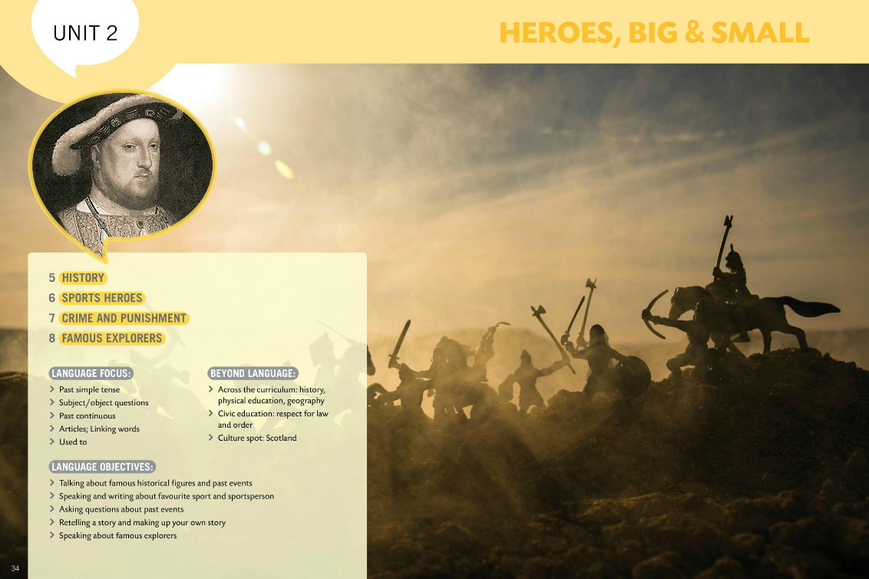
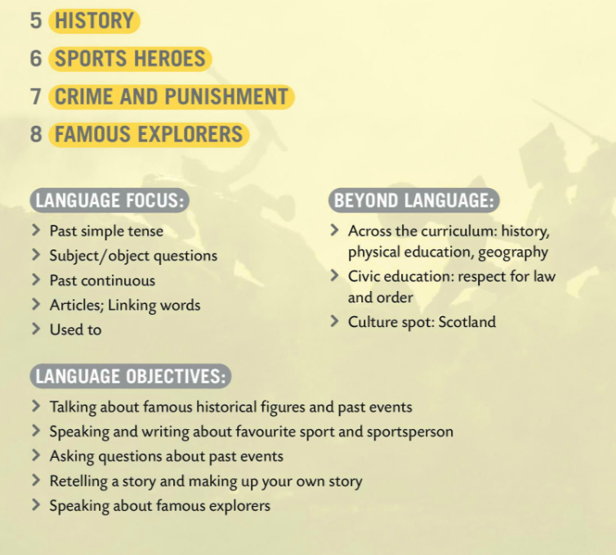

Slide 3
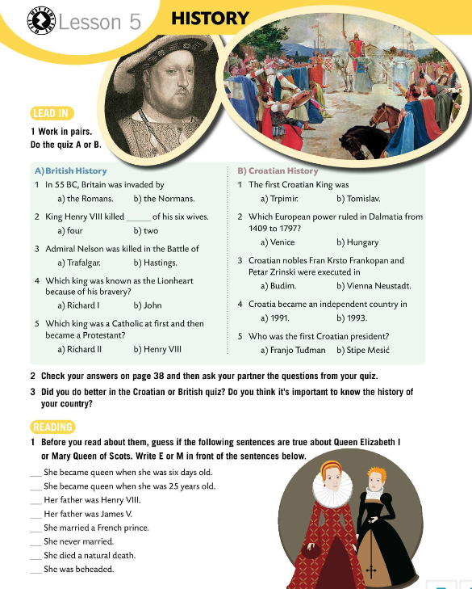
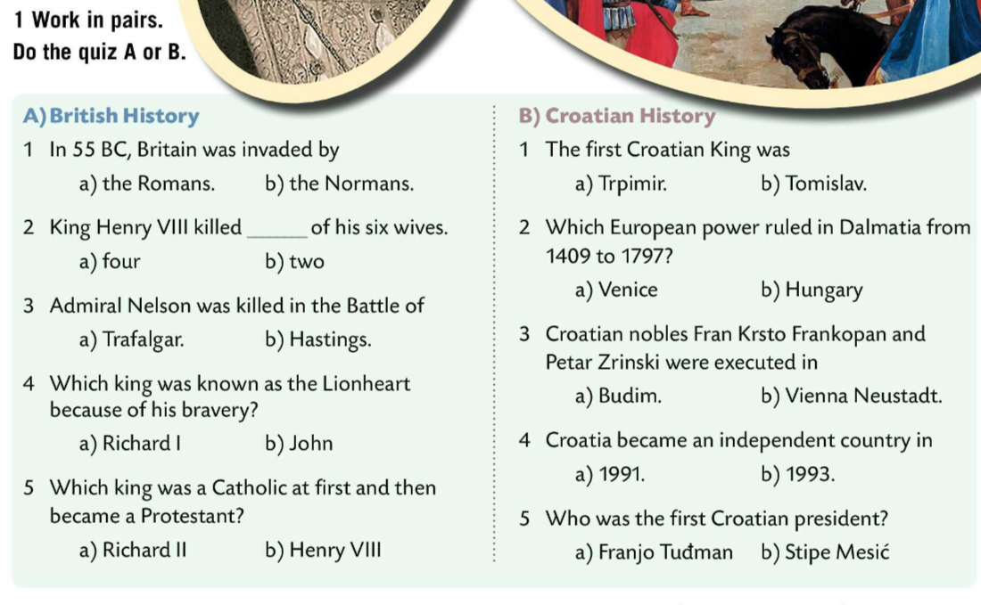
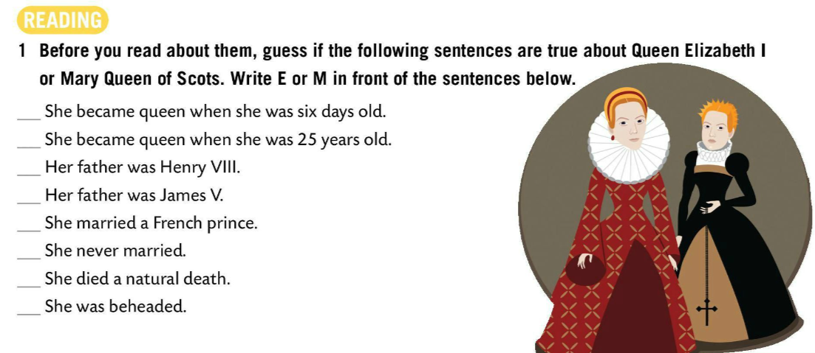
Work in pairs. Do the quiz A or B.
Check.
Do you think it’s important to know the history of your country?
Guess if the following sentences are true. Write E or M.

Slide 4
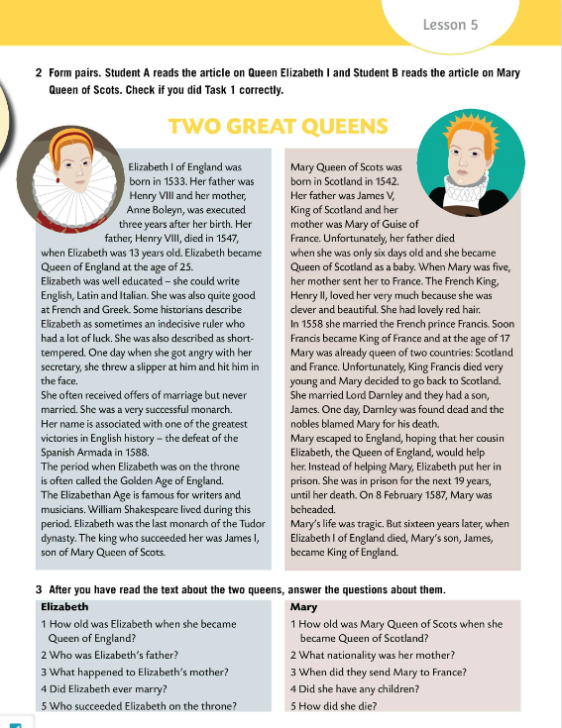
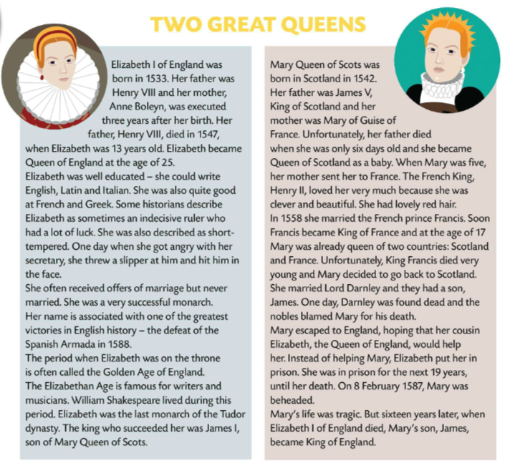

Form pairs. Student A reads the article on Queen Elizabeth I and Student B reads the article on Mary Queen of Scots.
Check Task 1.

Slide 5
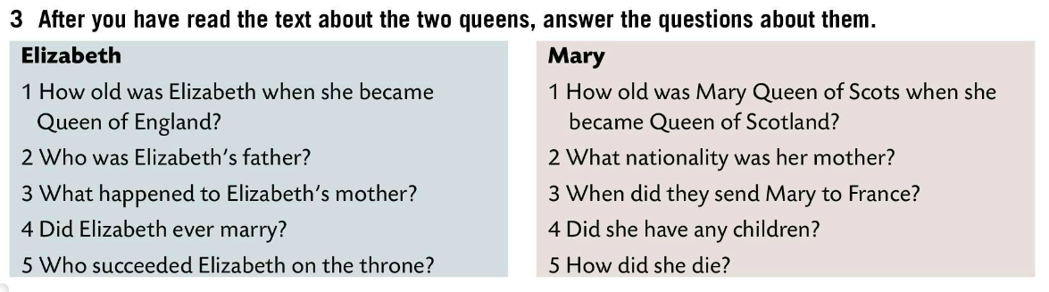
Answer the questions about the two queens.
Check.
Elizabeth
She was 25 years old.
Her father was Henry VIII.
She was executed three years after Elizabeth’s birth.
She never married.
James I, son of Mary Queen of Scots, succeeded her.
Mary
She was only six days old.
Her mother was French.
When she was five years old.
She had a son, James I.
She was beheaded.

Slide 6
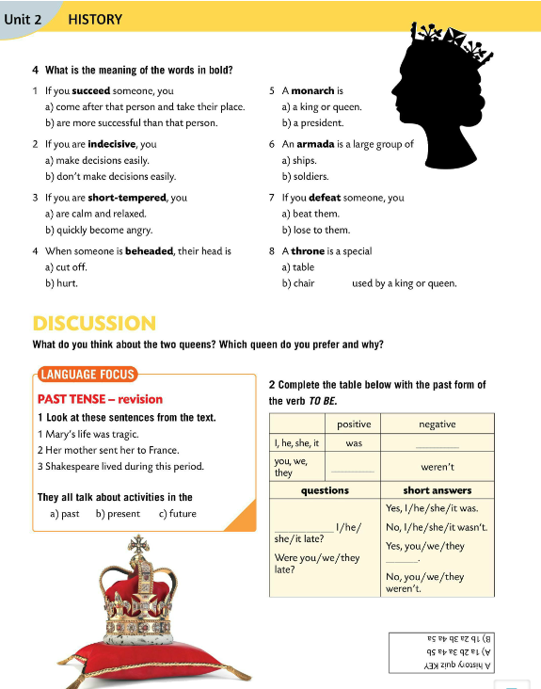
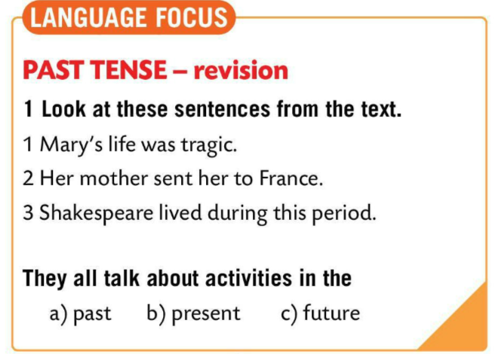
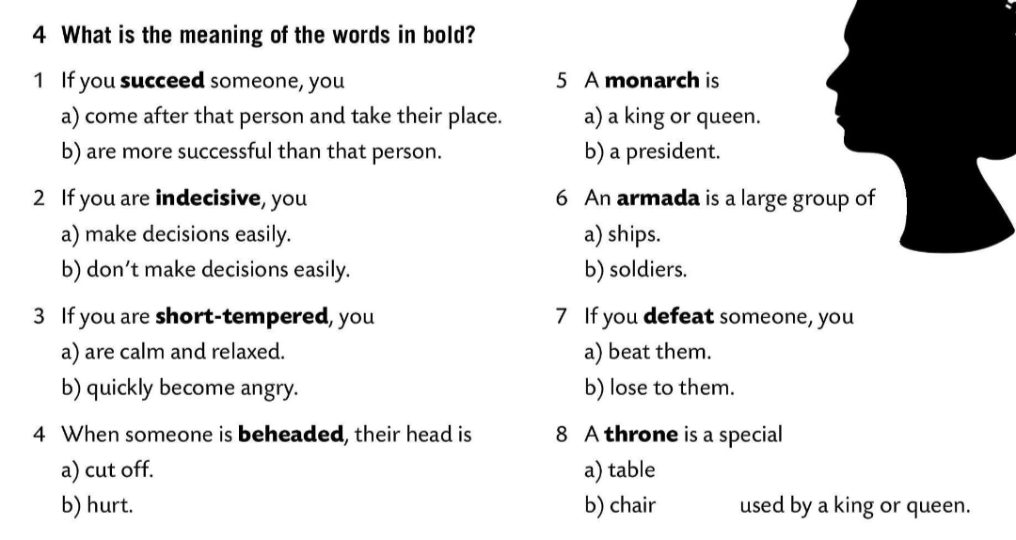
What is the meaning of the words in bold? Circle.
Translate the words into Croatian.
Which queen do you prefer and why?
Look at the sentences in LANGUAGE FOCUS box.
Check.

Slide 7
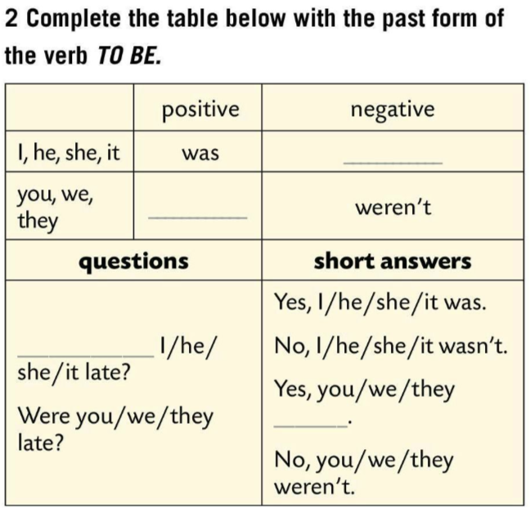
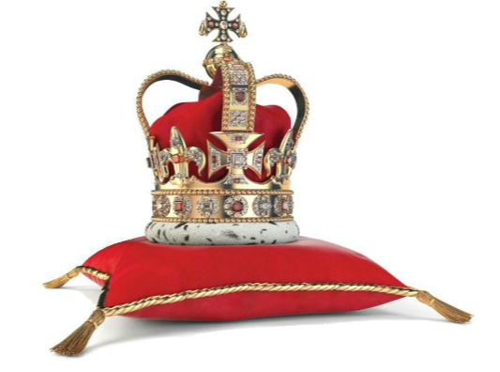
Fill in the table with the past form of the verb TO BE.
Check.
Play a game.
https://wordwall.net/play/846/524/844
wasn’t
were
Was
were

Slide 8
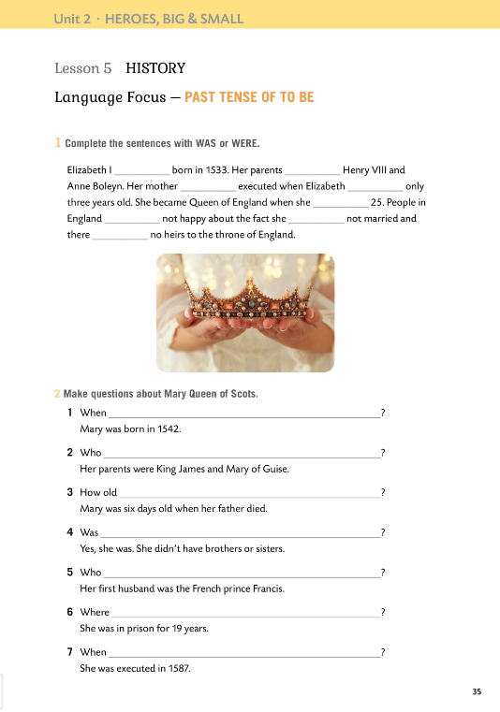

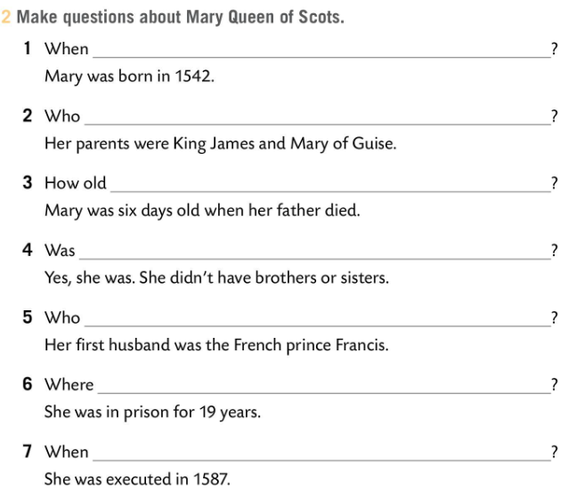
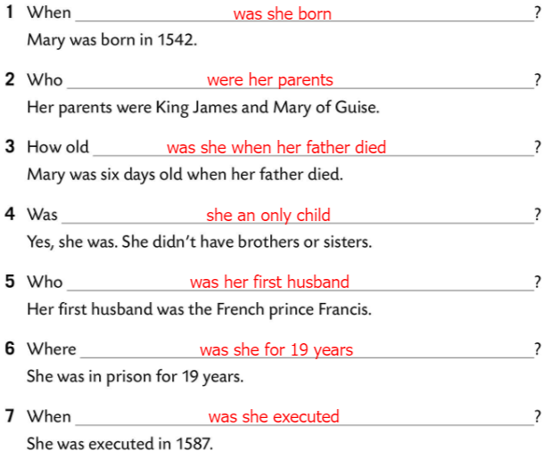
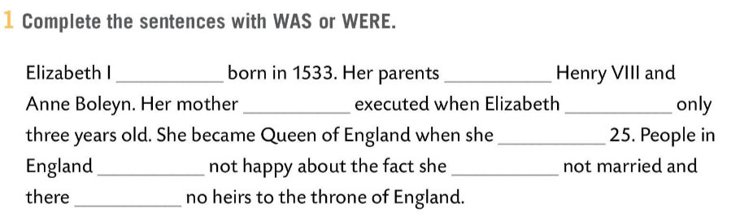
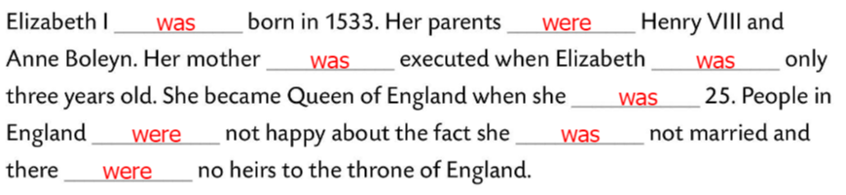
Workbook, page 35
Complete the sentences with WAS or WERE.
Check.
Make question about Mary Queen of Scots.
Check.

Slide 9
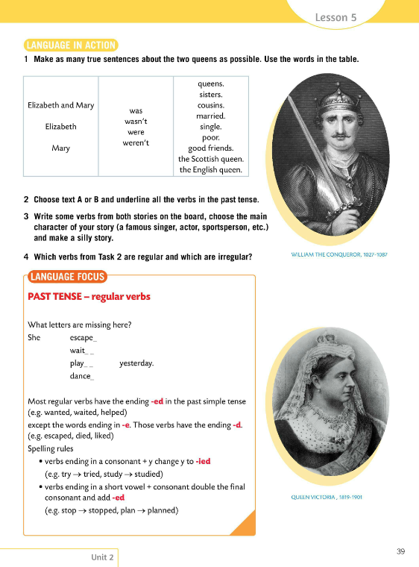
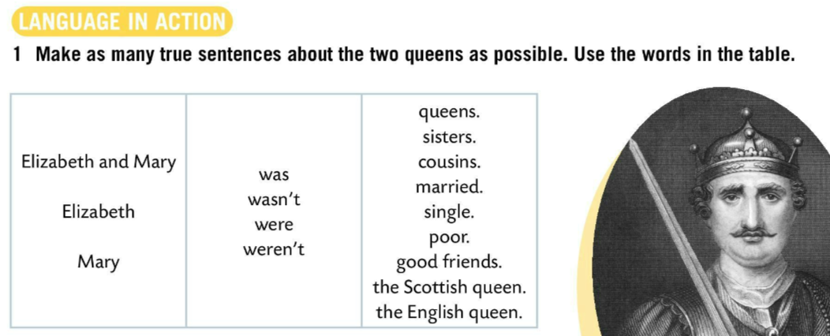
Make as many true sentences about the two queens as possible.
Choose text A or B and underline all the verbs in the past tense.
Write some verbs from both stories on the board, choose the main character of your story (a famous singer, actor, sportperson etc.) and make a silly story.
Which verbs from Task 2 are regular and which are irregular?

Slide 10
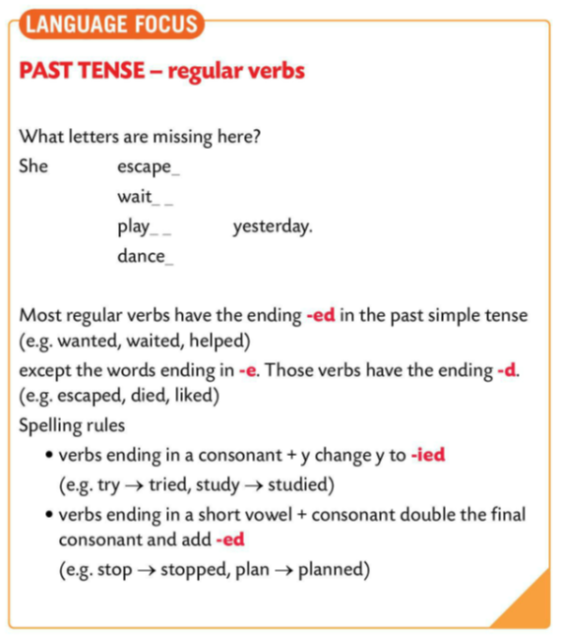
LANGUAGE FOCUS
Letters that are missing are –d and –ed.
escaped
waited
played
Danced
Most regular verbs end in –ed in the past simple tense (e.g. wanted, waited, helped).
Većina pravilnih glagola u prošlom glagolskom vremenu past simple ima nastavak –ed (na primjer wanted, waited, helped).

Slide 11
Verbs ending in –e have the ending –d (e.g. escaped, died, liked).
Glagoli koji završavaju na –e imaju nastavak –d (npr. escaped, died, liked).
Verbs ending in a consonant + -y -y to –ied
try → tried
study → studied
Verbs ending in a short vowel + consonant double the final consonant and add –ed.
stop →stopped
plan → planned

Slide 12
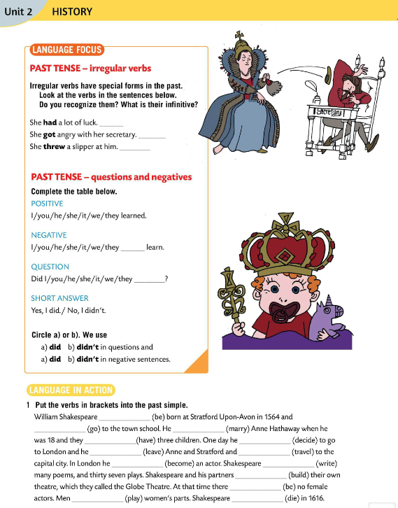
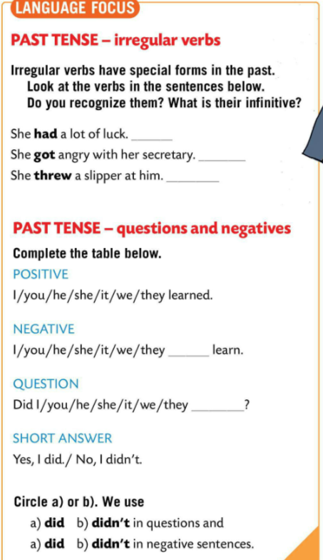
Past tense – irregular verbs
Irregular verbs have special forms in the past.
Nepravilni glagoli imaju poseban oblik u prošlosti.
Look at the verbs in the sentences. What is their infinitive?
Check.
have
get
throw
didn’t
Past tense – questions and negatives
Complete the table and circle a) or b) to finish the rules.
Copy the rules into your notebook.
Check.
learn

Slide 13
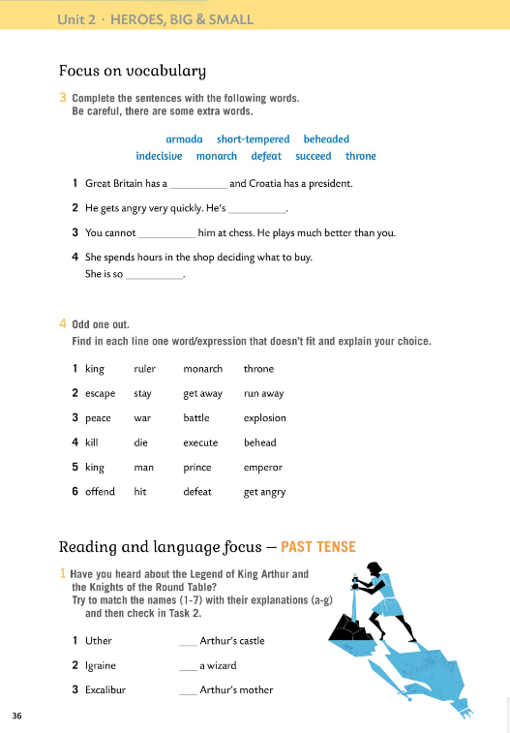
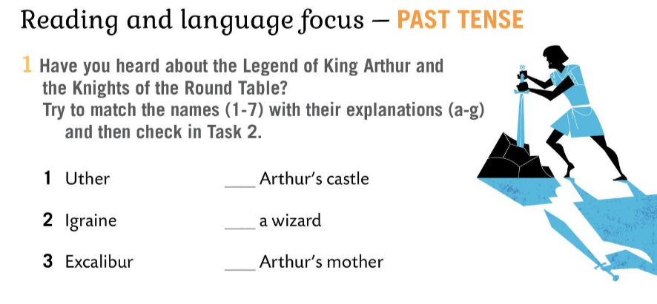
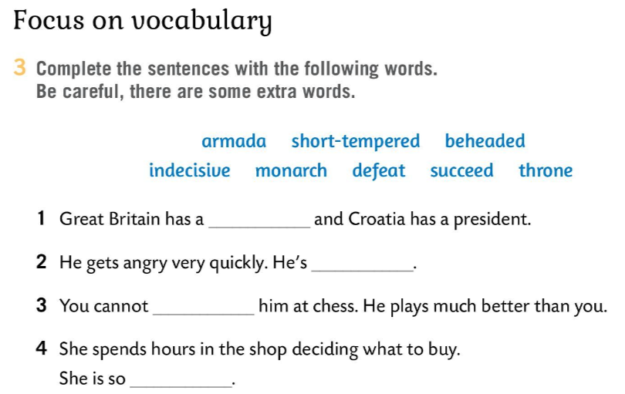
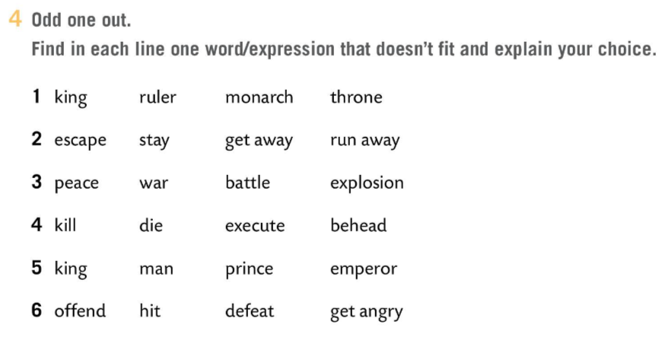
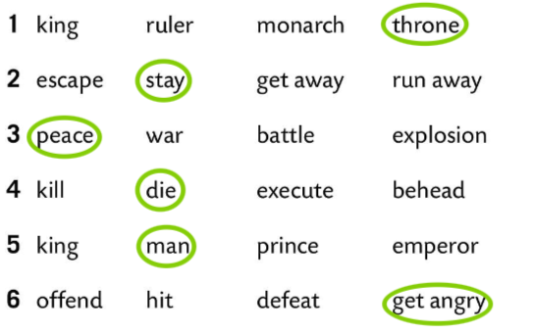
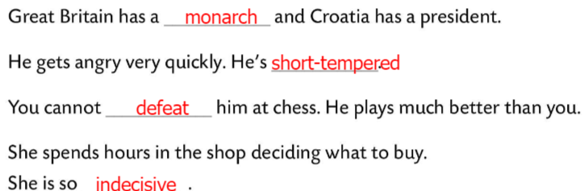
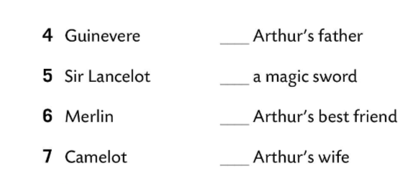
Workbook, page 36
Complete the sentences with the words in Task 1.
There are some extra words.
Check.
Odd one out.
Explain your choice.
Check.
Have you ever heard about the Legend of King Arthur and the knights of the Round Table?
Match the names (1-7) with their explanations (a-g).
Check in Task 2.

Slide 14
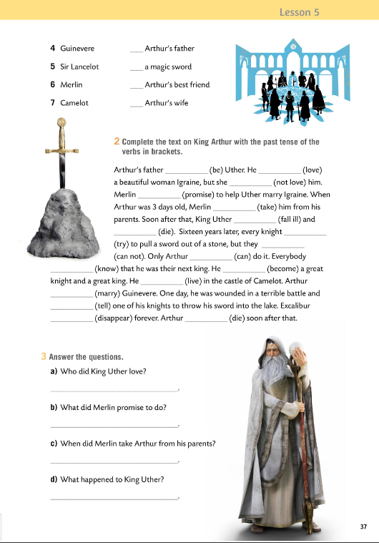
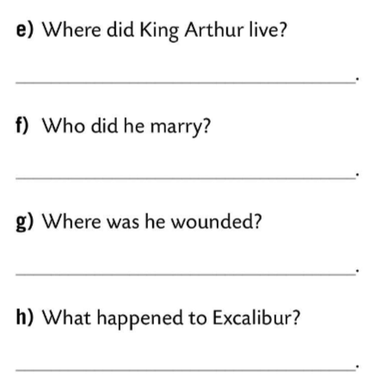
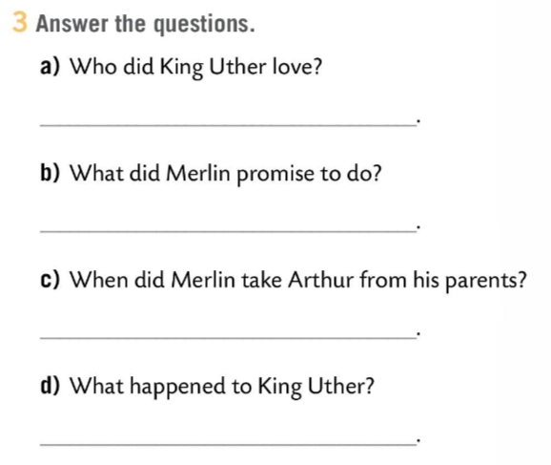
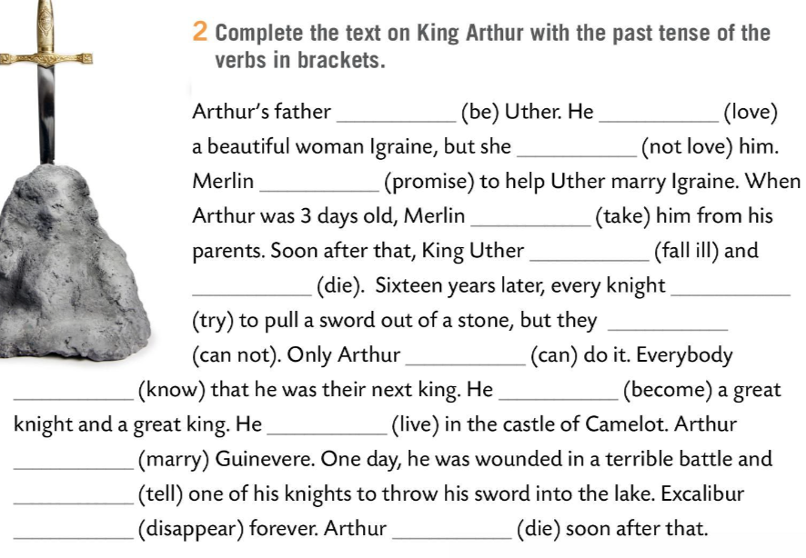
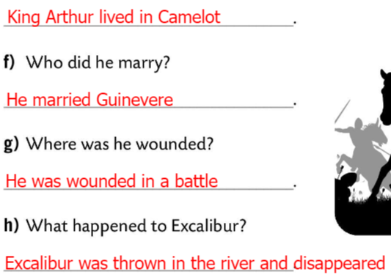
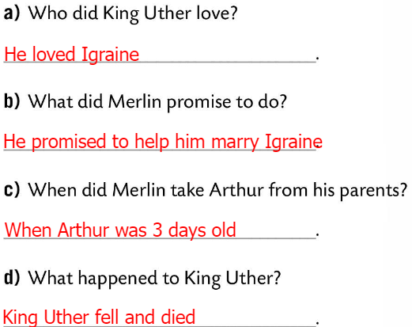
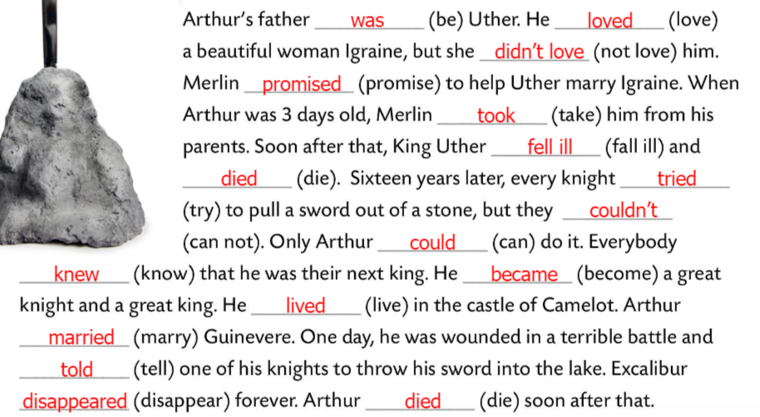


Workbook, page 37
Complete the text on King Arthur with the past tense of the verbs in brackets.
Check.
Check Task 1.
Answer the questions.
Check.

Slide 15
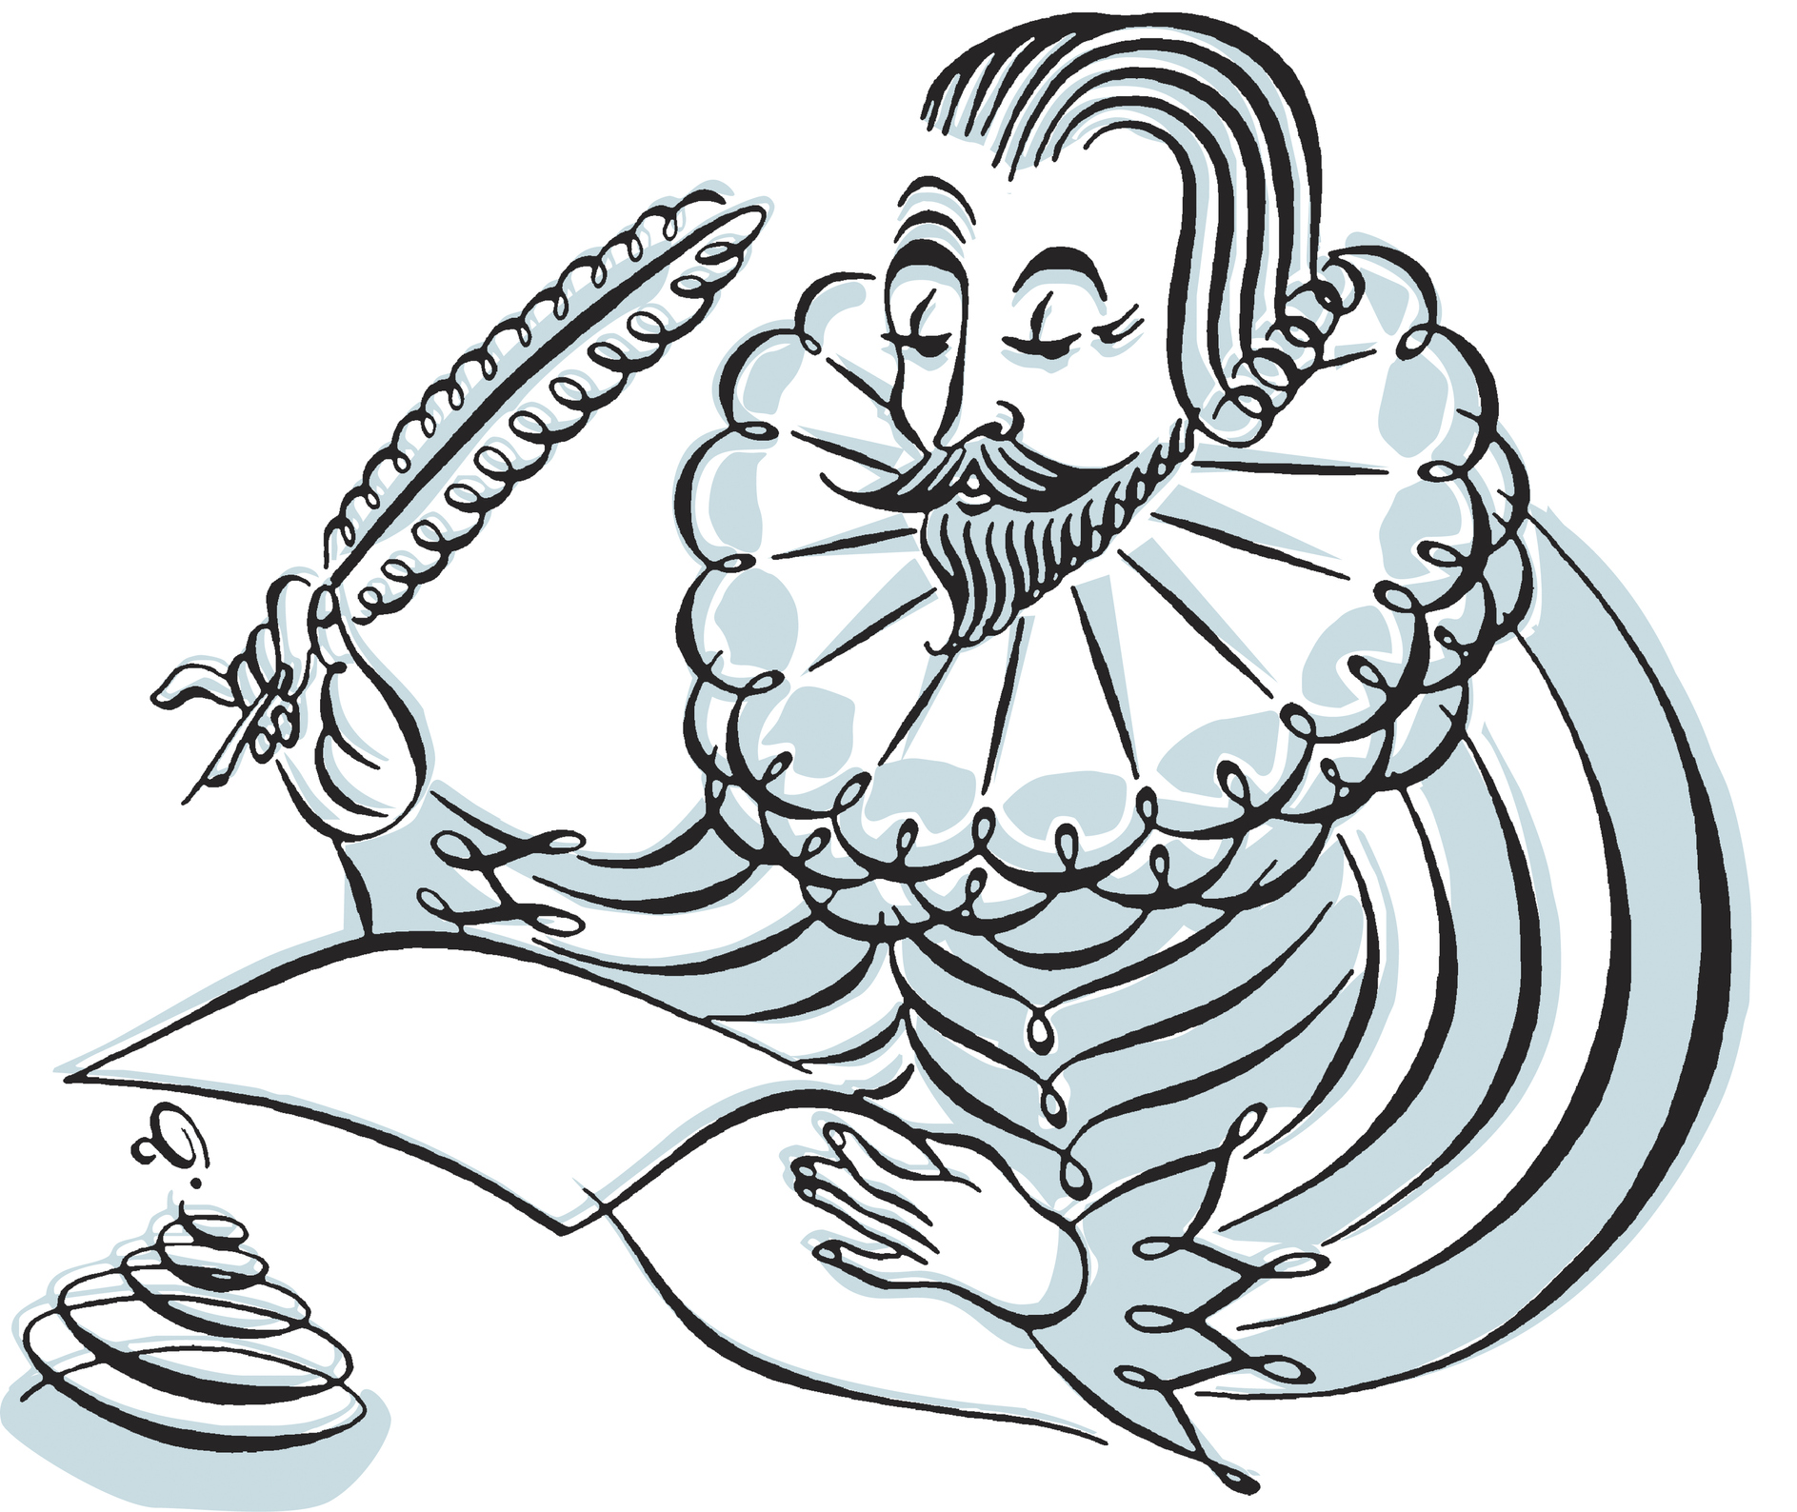
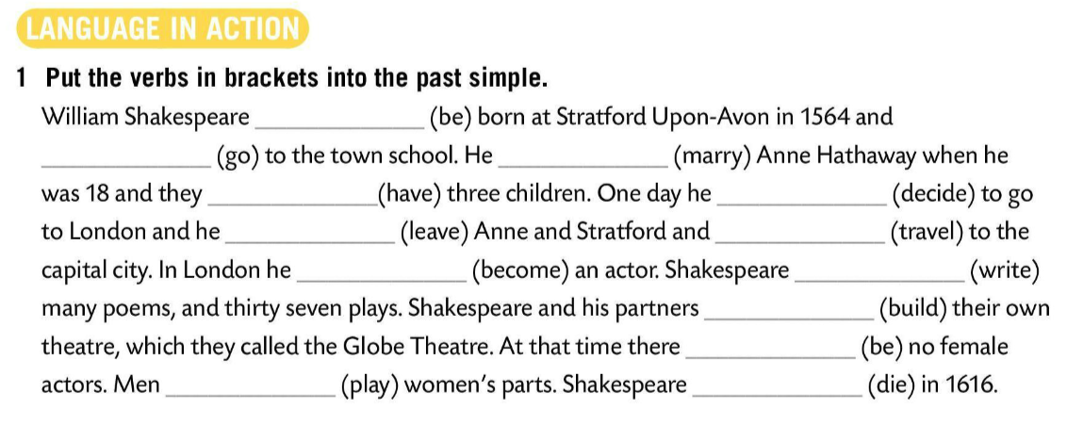
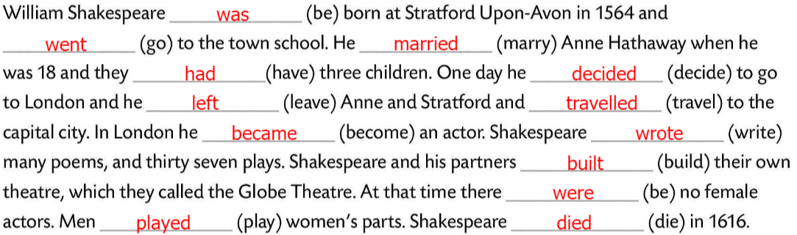
Put the verbs in brackets into the past simple.
Check.

Slide 16
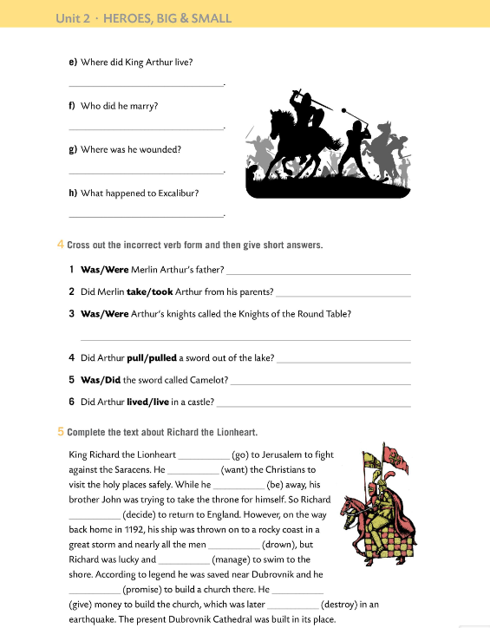
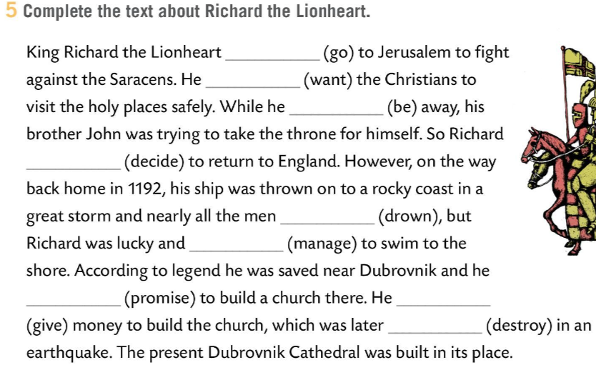
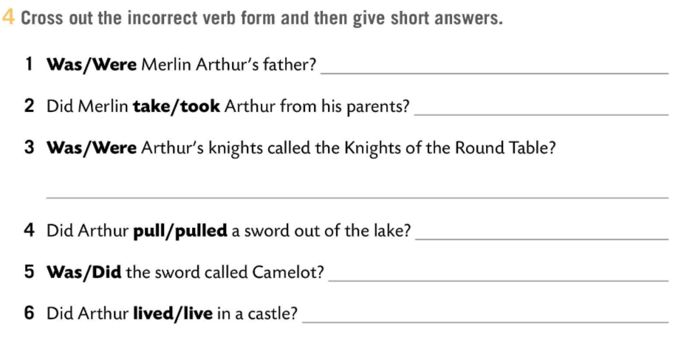

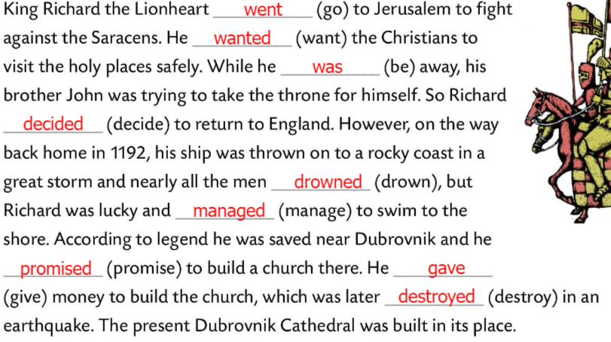
Workbook, p. 38
Cross out the incorrect verb form and then give short answers.
No, he wasn’t.
Check.
Yes, he did,
Yes, they were.
Complete the text about Richard the Lionheart.
No, he didn’t.
No, it wasn’t.
Yes, he did.
Check.

Slide 17
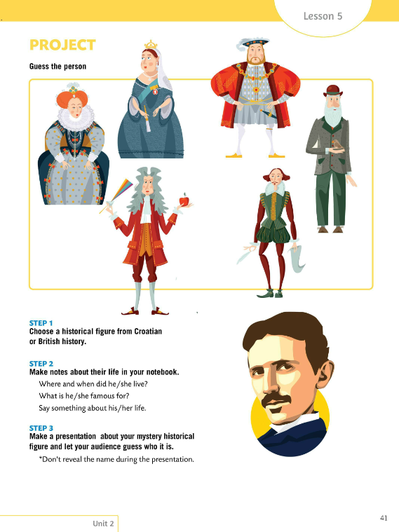
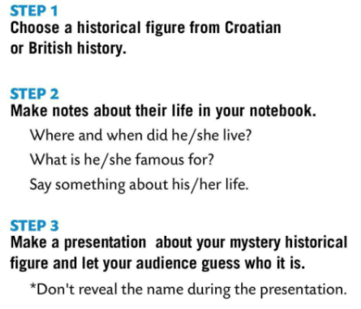
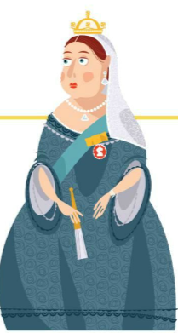
PROJECT – GUESS THE PERSON
Choose a historical figure from Croatian or British history.
Make notes about their life in your notebook.
Make a presentation about your mystery historical figure and let your audience guess who it is. ☺

